Slide 1
CSC00004 Software engineering

Slide 2
Content
Fundamentals
The Software Engineering Discipline
The Software Life Cycle
Development Phases
Software Engineering Methodologies
Documentation
Project Management
Other Aspects in SE
Software Design: Modularity
Tools of the Trade
Software Ownership and Liability
SE Department – FIT – HCMUS

Slide 3
Fundamentals

Slide 4
The Software Engineering Discipline
Distinct from other engineering fields
Prefabricated components
Metrics
Practitioners versus Theoreticians
Professional Organizations: ACM, IEEE…
Codes of professional ethics

Slide 5
Computer Aided Software Engineering (CASE) tools
Project planning
Project management
Documentation
Prototyping and simulation
Interface design
Programming
Configuration management (git)
Collaboration (Slack, Trello)

Slide 6
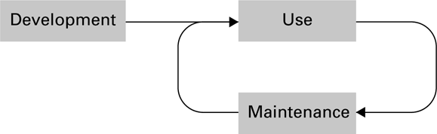
The software life cycle
Enhancement

Slide 7
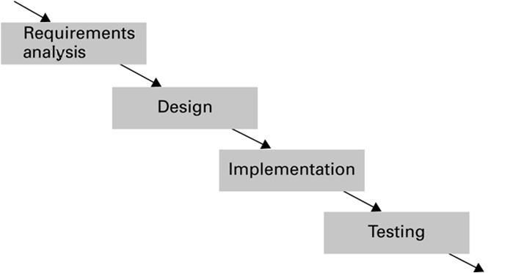
The development phase of the software life cycle

Slide 8
Analysis Stage
Requirements
Application oriented
Specifications
Technically oriented
Software requirements document

Slide 9
Design Stage
Methodologies and tools
Human interface (psychology and ergonomics)

Slide 10
Implementation Stage
Create system from design
Write programs
Create data files
Develop databases
Role of “software analyst” versus “programmer”

Slide 11
Testing Stage
Validation testing
Confirm that system meets specifications
Defect testing
Find bugs
Level of test
Unit testing
Integration testing
System testing

Slide 12
Software Testing Strategies
Glass-box testing (white-box testing)
Pareto principle
Basis path testing
Black-box testing
Boundary value analysis
Redundancy testing
Beta testing

Slide 13
Software Engineering Methodologies
Waterfall Model
Incremental Model
Prototyping (Evolutionary vs. Throwaway)
Open-source Development
New Methodologies
Agile
Extreme Programming

Slide 14
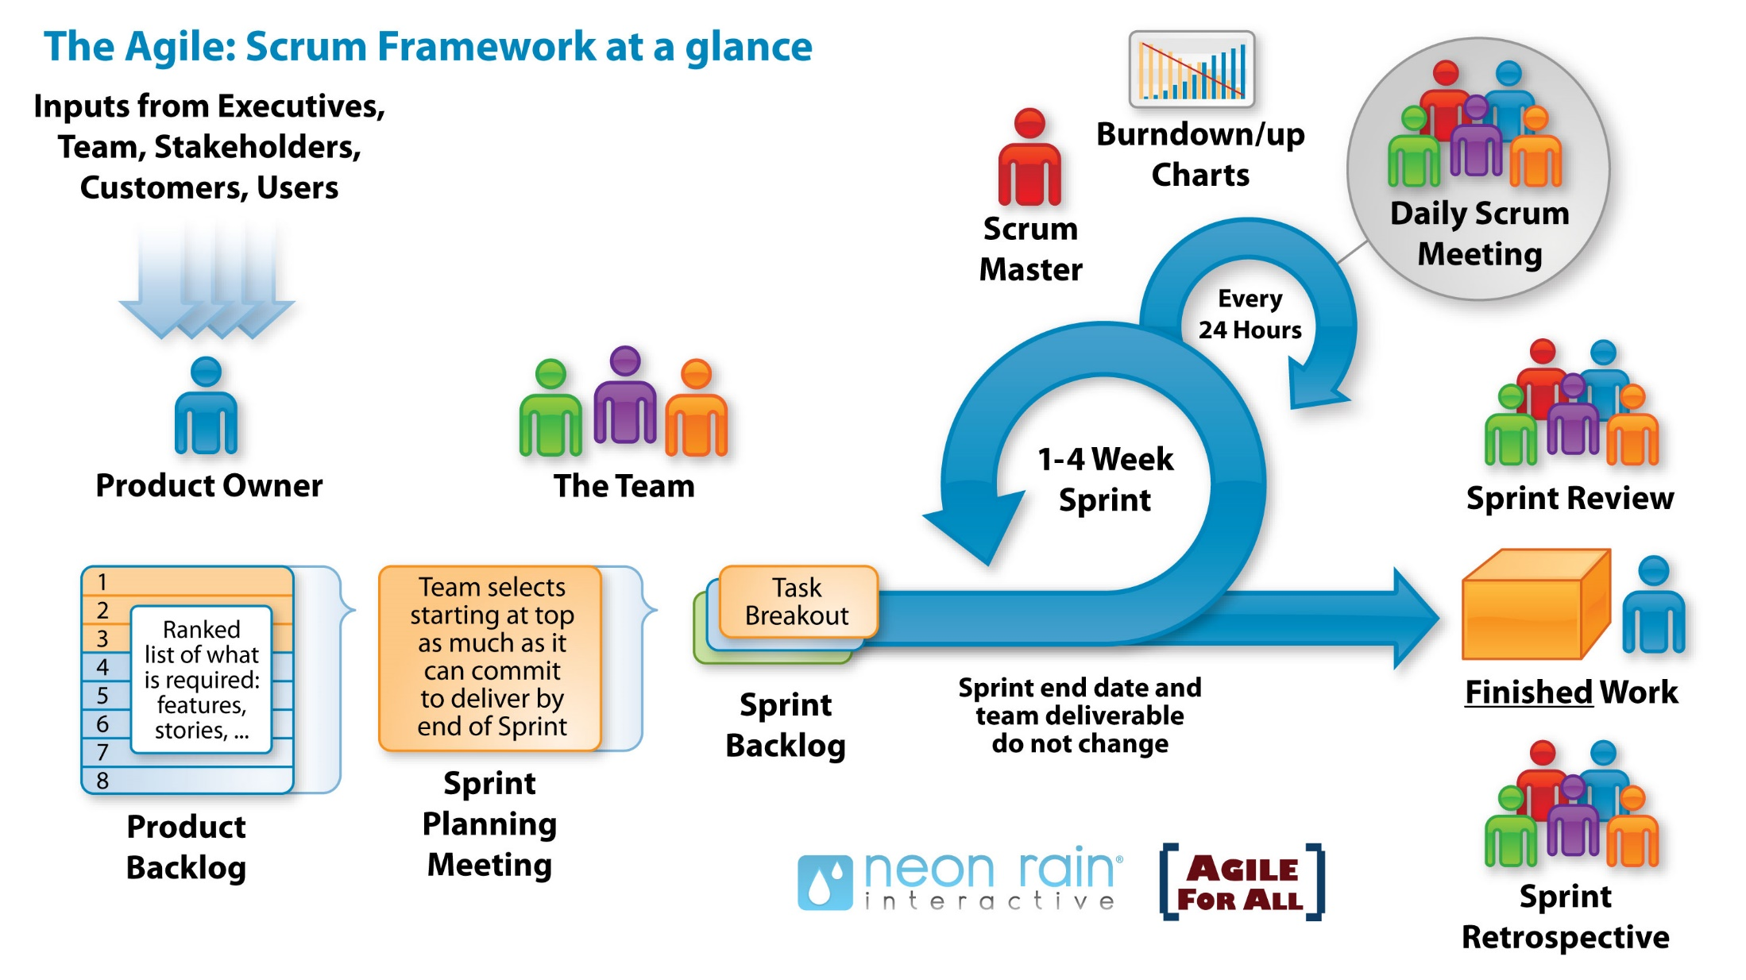
Scrum

Slide 15
Documentation
User Documentation
Printed book for all customers
On-line help modules
System Documentation
Source code
Requirement, analysis, design, test, maintenance documents
Technical Documentation
For installing, customizing, updating, etc.
Support documentation
For management, team working, collaboration

Slide 16
Project Management
A dynamic process that utilizes the appropriate resources of the organization in a controlled and structured manner, to achieve some clearly defined objectives identified as needs
Consist of
Project Planning
Project Monitoring and Control
Management of Scope, Time, Cost, Risk, Quality, Human Resource, Communication, Procurement

Slide 17
Other Aspects of SE

Slide 18
Software Design – Modularity
Functions − Imperative paradigm
Structure charts
Class − Object-oriented paradigm
Collaboration diagrams
Components − Component architecture
Services – Service-oriented architecture (SOA)

Slide 19
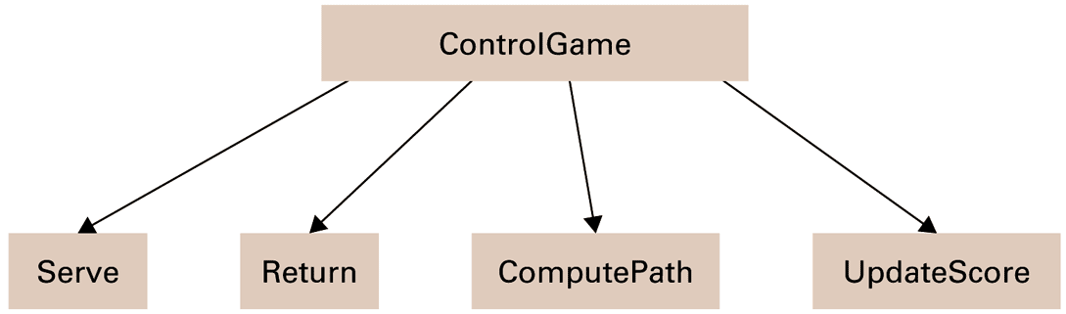
A simple structure chart

Slide 20
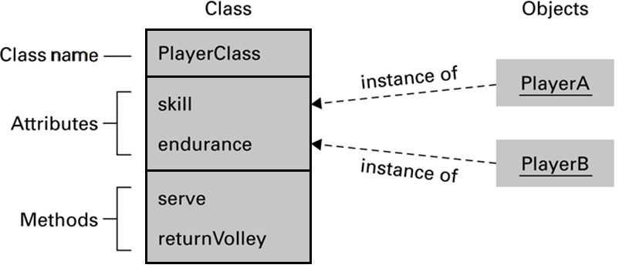
The structure of PlayerClass and its instances

Slide 21
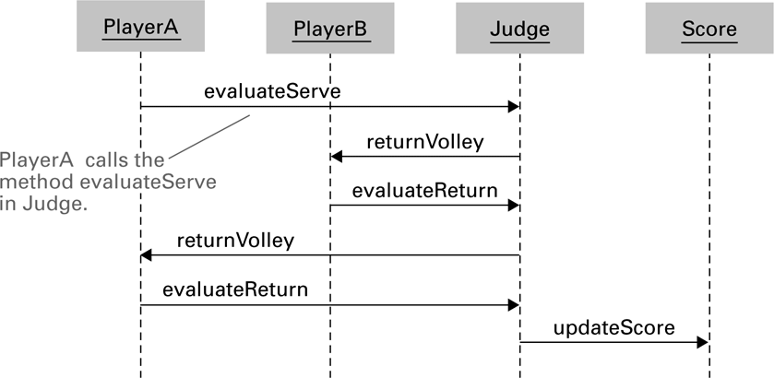
The interaction between objects resulting from PlayerA’s serve

Slide 22
Coupling vs. Cohesion
Coupling
Control coupling
Data coupling
Cohesion
Logical cohesion
Functional cohesion

Slide 23
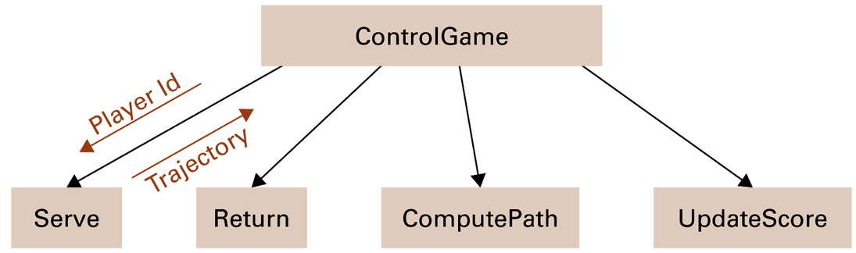
A structure chart including data coupling

Slide 24
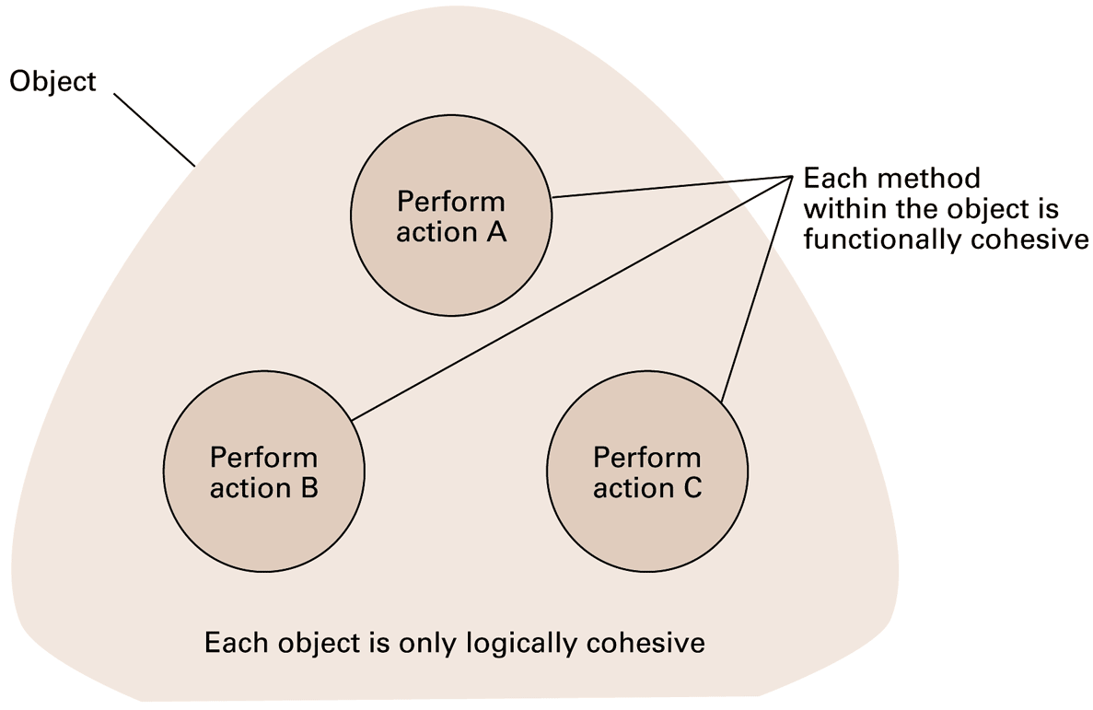
Logical and functional cohesion within an object

Slide 25
Unified Modeling Language
Use Case Diagram
Use cases
Actors
Class Diagram
Class
Relationship: generalization, association, dependency

Slide 26
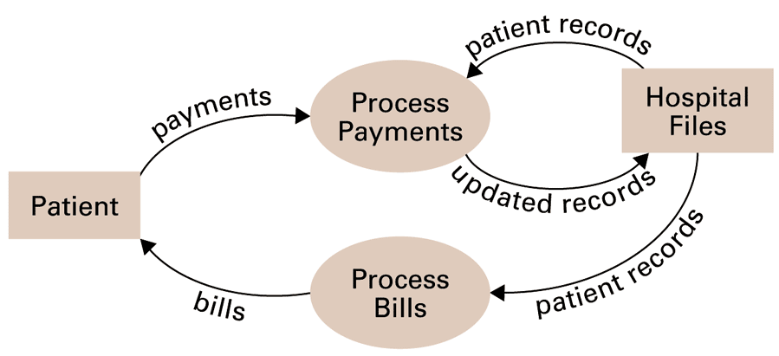
A simple dataflow diagram

Slide 27
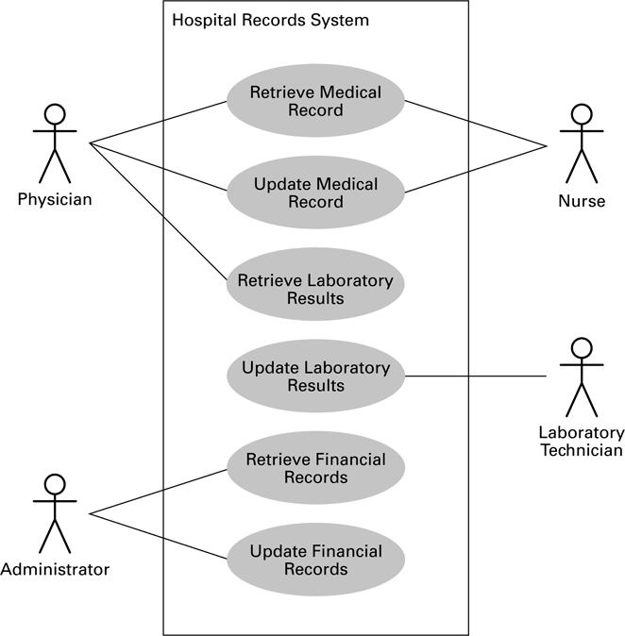
A simple use case diagram

Slide 28
A simple class diagram

Slide 29
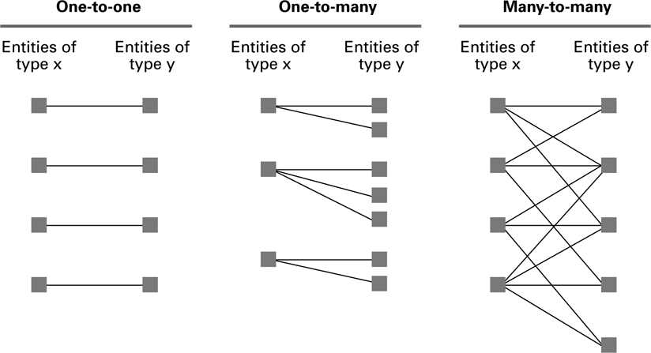
Relationships between entities of types X and Y

Slide 30
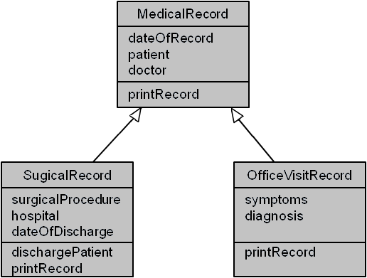
A class diagram depicting generalizations

Slide 31
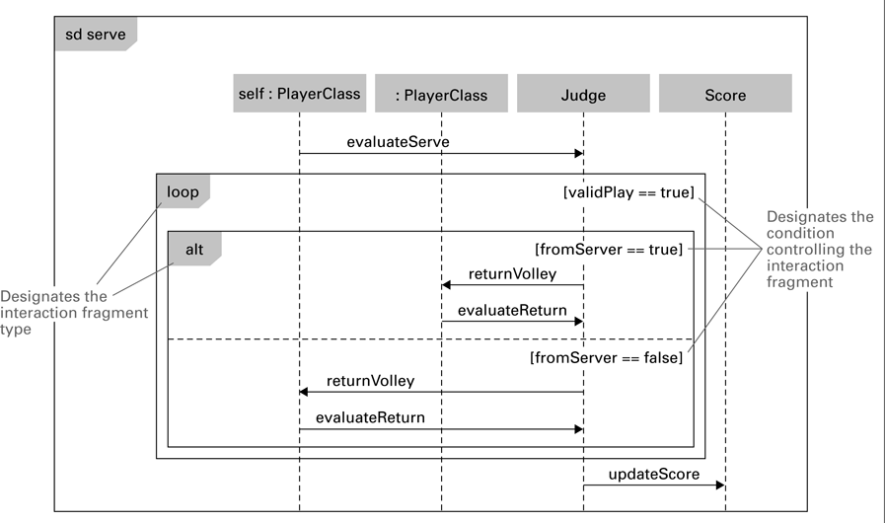
A sequence diagram depicting a generic volley

Slide 32
Structured Walkthroughs
“Theatrical” experiment
Class-responsibility-collaboration cards

Slide 33
Design Patterns
Well designed “templates” for solving recurring problems
Examples:
Adapter pattern: Used to adapter a module’s interface to current needs
Decorator pattern: Used to control the complexity involved when many different combinations of the same activities are required
Inspired by the work of Christopher Alexander in architecture

Slide 34
Software Ownership
Copyright
Allow a product to be released while retaining ownership of intellectual property
Asserted in all works:
Specifications
Source code
Final product

Slide 35
Software Ownership (continued)
Software License
A legal agreement that grants the user certain permissions without transferring ownership
Open source license
Patents
Must demonstrate that it is new, usable, and not obvious to others with similar backgrounds
Process is expensive and time-consuming

Slide 36
Department of Software Engineering

Slide 37
Introduction
Room: I82
Phone: (028) 38 324 467 (ext: 802)
Head of department
Dr. Nguyen Van Vu
Vice head of department
Dr. Nguyen Thi Minh Tuyen

Slide 38
Human resources
31 staffs are working in VN
Associate Professor – 1
Doctor – 5
M.Sc. – 24
B.Sc. – 1 (graduate student)

Slide 39
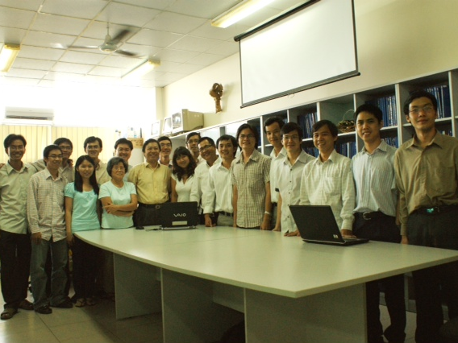
Bộ Môn CNPM

Slide 40
Software engineering
A discipline related to all aspects of professional software development
Goal : develop a software system with
High quality
Low cost
On time
Customer satisfaction

Slide 41
Importance of SE
Software is an indispensable part of modern life
The industries depend on software
SE helps to develop software
Lower costs
Shorter time
Better response

Slide 42
Importance of SE (cont.)
Examples
Programing languages are easier to use
From Assembly to Fortran, C, Cobol, C++, Java
From waterfall process to agile process
Programming tools are more diverse and modern

Slide 43
Challenges in SE
Report of Standish Group Chaos 2003
The rate of successful software projects is low
On schedule and cost
Extend time and cost
Fail

Slide 44
Challenges in SE (cont.)
Software is different from hardware
Cannot touch
Flexible, easy to edit
Depend on human
Diverse
Environment
OS, devices
Functions, development approaches

Slide 45
Educational objectives
Ability to analyze requirements, design, test and deploy software systems
Ability to learn to use and self-study software development tools
Ability to self-study and research new technologies, methods and processes in software industry

Slide 46
Required courses of SE major
Students accumulate at least 5 courses
Nhập môn công nghệ phần mềm
Quản lý dự án phần mềm
Phân tích và quản lý yêu cầu phần mềm
Lập trình Windows
Phân tích và thiết kế phần mềm
Phát triển ứng dụng Web
Kiểm chứng phần mềm
Phát triển game
Phát triển phần mềm cho thiết bị di động

Slide 47
Optional courses
Students accumulate at least 5 courses, which contain at least 2 courses (8 credits) of SE department
Các chủ đề nâng cao trong CNPM
Thiết kế giao diện
Thuật toán tổ hợp và ứng dụng
Mô hình hóa phần mềm
Nhập môn tư duy thuật toán
Kiến trúc phần mềm
Quy hoạch tuyến tính
Thanh tra mã nguồn
Khởi nghiệp (2 tín chỉ)
Kiến tập nghề nghiệp (3 tín chỉ)

Slide 48
Optional courses (cont.)
Mẫu thiết kế HĐT và ứng dụng
Đặc tả hình thức
Lập trình hướng đối tượng nâng cao
Công nghệ XML và ứng dụng
Lập trình ứng dụng Java
Công nghệ Java cho hệ thống phân tán
Phát triển phần mềm nguồn mở
Phát triển phần mềm cho hệ thống nhúng
Thực tập thực tế

Slide 49
Correlation of courses and SE
Analyze
QLYC
Design
Phân tích và thiết kế phần mềm
Implement
Xây dựng phần mềm
Test
Kiểm chứng phần mềm
Thanh tra mã nguồn
Mô hình hóa
Mô hình hóa
Kiến trúc phần mềm
Lập trình *
Công nghệ *
Công nghệ *
Lập trình
Thiết kế giao diện
Thiết kế giao diện
Mẫu thiết kế HĐT & ứng dụng
Nhập môn CNPM
Quản lý dự án phần mềm
Các chủ đề nâng cao trong CNPM

Slide 50
Career orientation
Analyze
Business Analyst
Design
Technical Architect
Implement
Developer
Test
Tester
Team Leader
Project Manager
Consultant

Slide 51
Career orientation (cont.)
- Developer
- Tester
- Project Manager
- Consultant
- Team Leader
- Business Analyst
- Technical Architect

Slide 52
Research directions
Software estimation
Test automation
Mining software repositories
Software cloud-based services
Software engineering education
Software verification and validation
Human computer interaction

Slide 53
Research directions (cont.)
Software design, software architecture and software design patterns
Engineering of desktop, web and mobile enterprise software
Cloud computing application development
Applying AI/ML/NLP to address software engineering problems

Slide 54
Research groups
Associate Prof. Trần Minh Triết
Dr. Đinh Bá Tiến
Dr. Nguyễn Văn Vũ
Dr. Nguyễn Thị Minh Tuyền
Dr. Ngô Huy Biên

